Slide 1

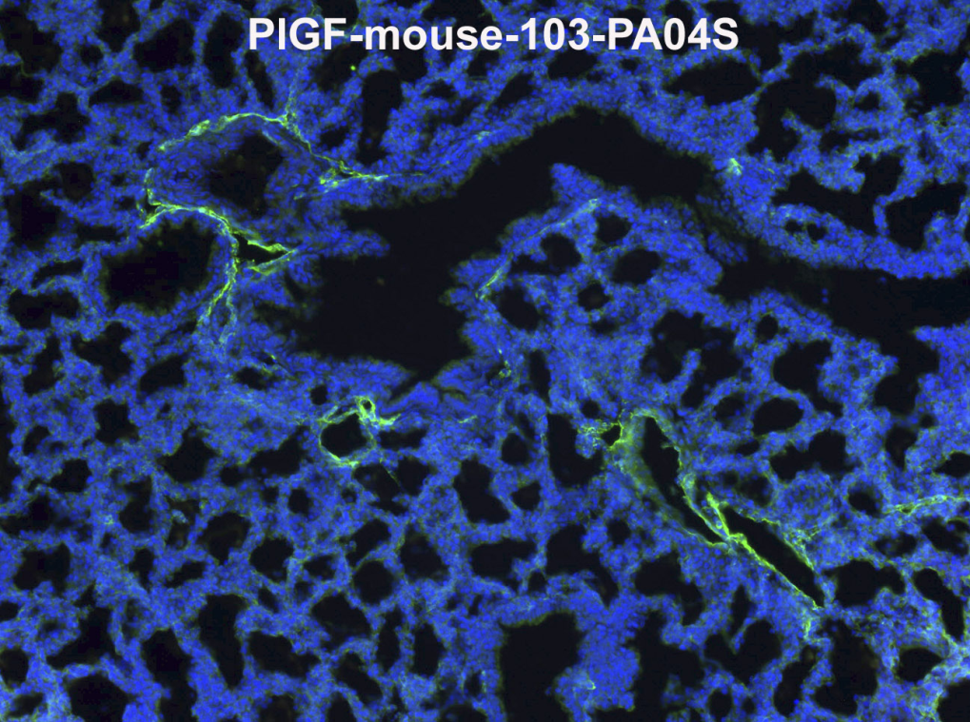
ReliaTech GmbH
Rabbit anti-mouse PlGF
(Cat# 103-PA04S/-PA04)
Immunofluorescence staining (green) of mouse lung tissue (ED18) with anti-mouse PlGF [Cat# 103-PA04S].
The experiment was performed by the research group of Prof. Dr. J. Wilting, University Göttingen, Germany.
http://www.reliatech.de / orders@reliatech.de

